Slide 1

Machine Learning Algorithms

Slide 2
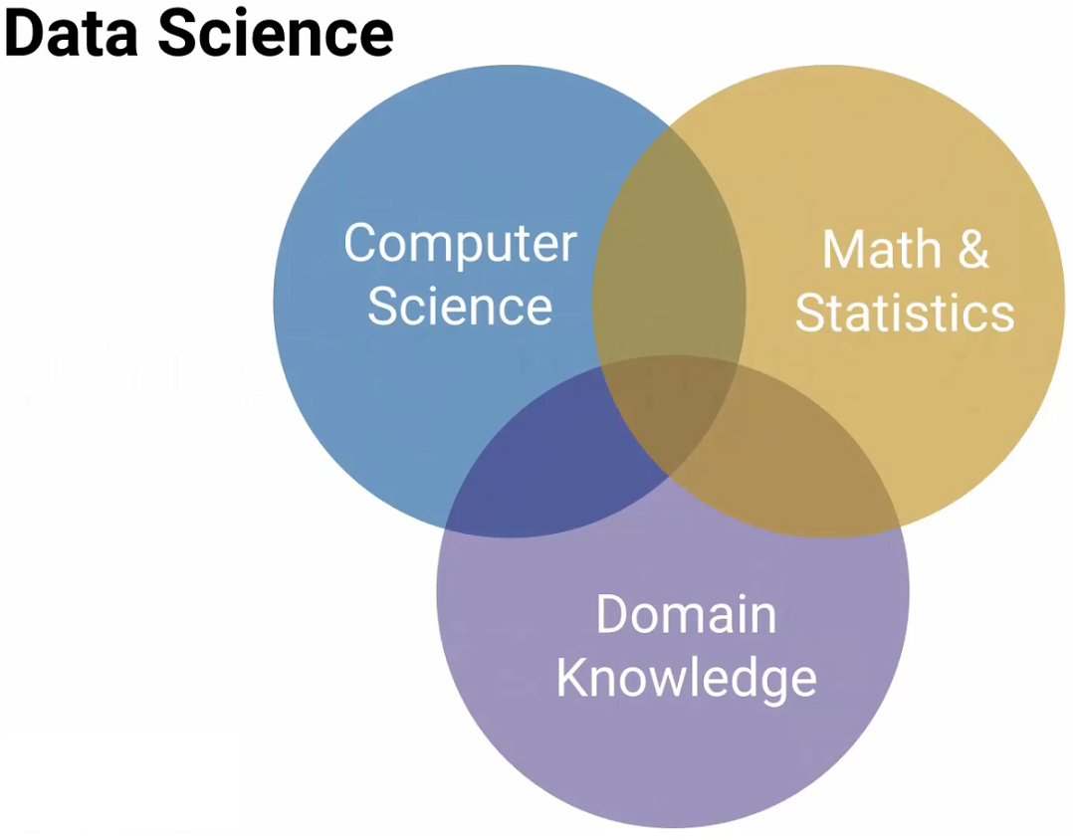

Slide 3
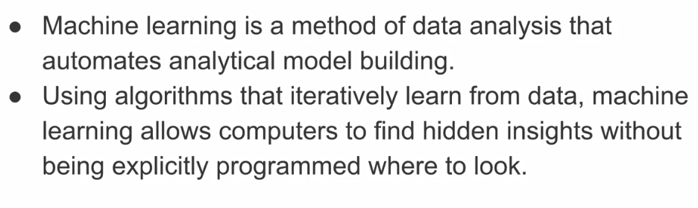

Slide 4
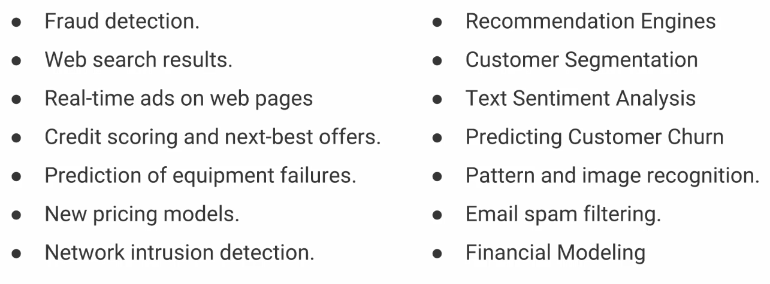

Slide 5
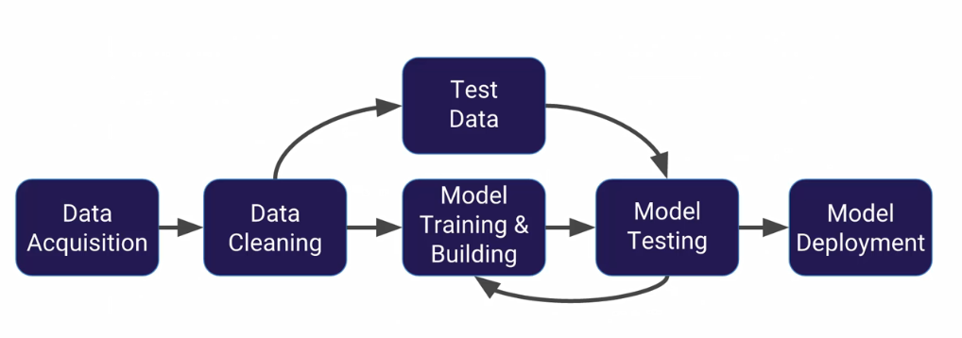

Slide 6
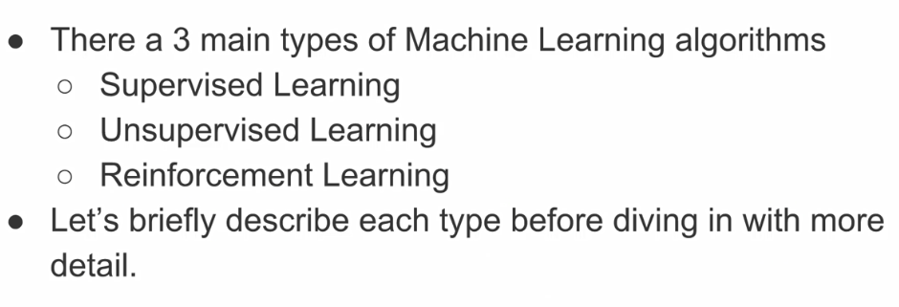

Slide 7
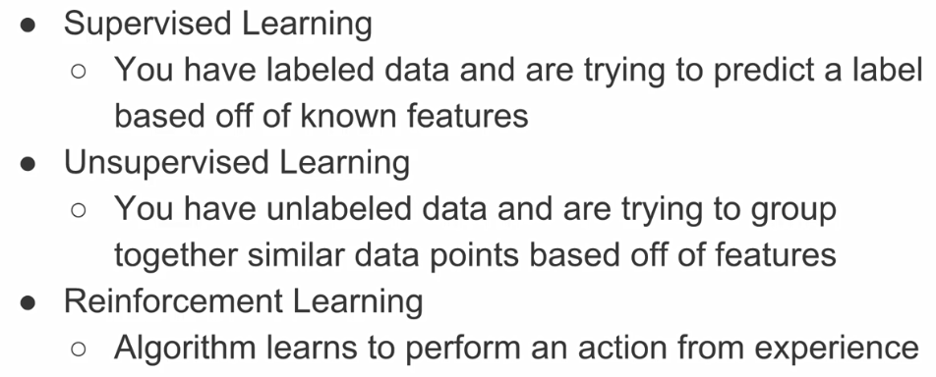

Slide 8
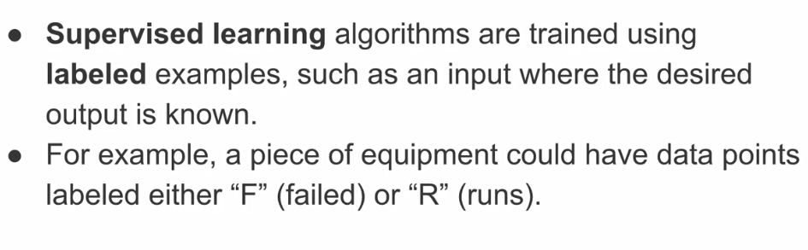
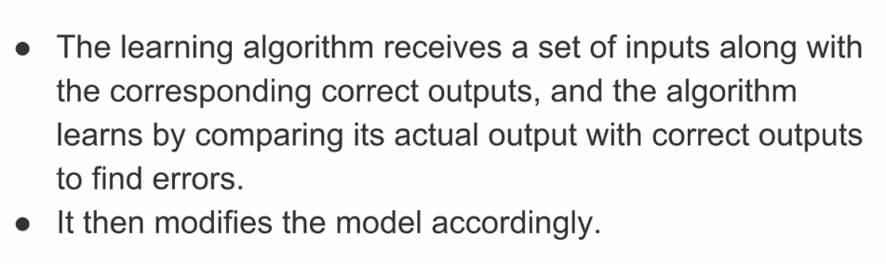

Slide 9
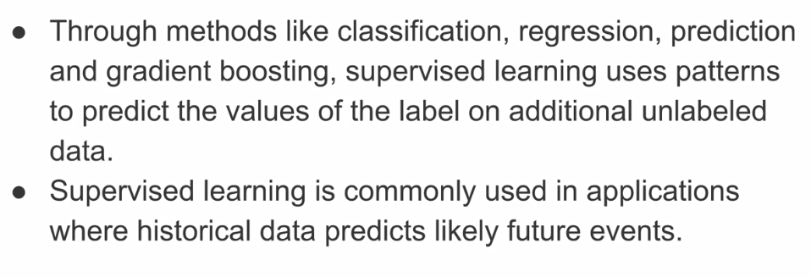

Slide 10
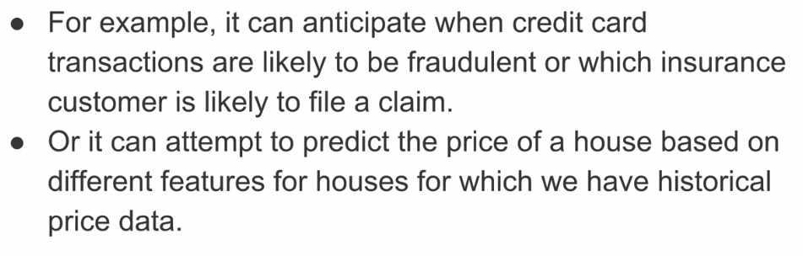

Slide 11
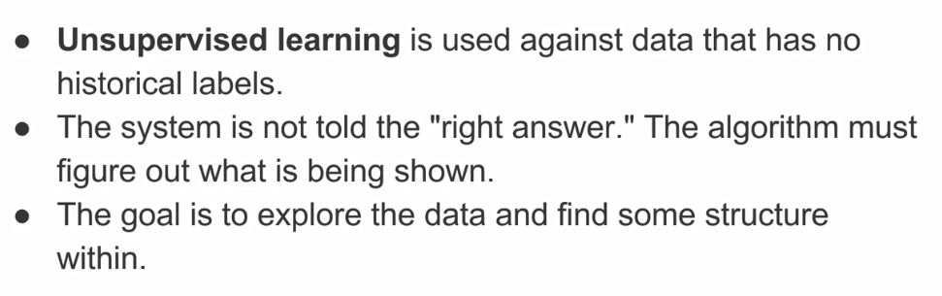

Slide 12
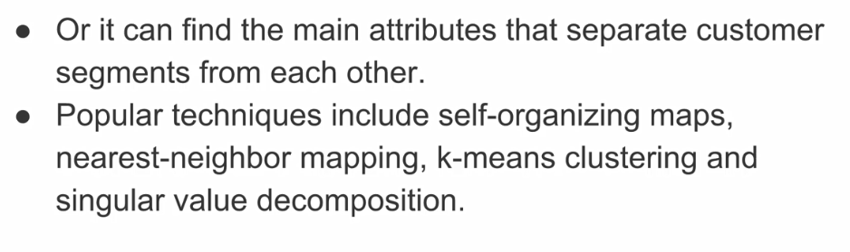

Slide 13
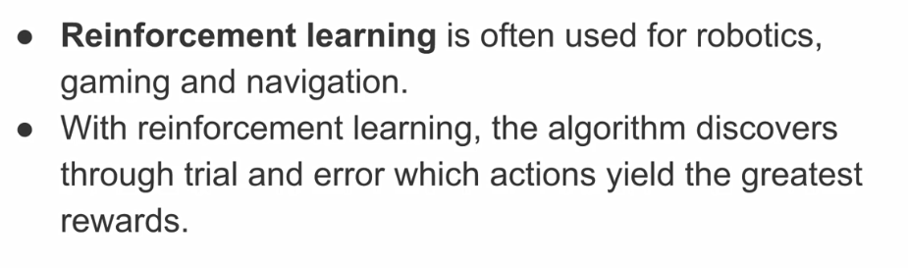
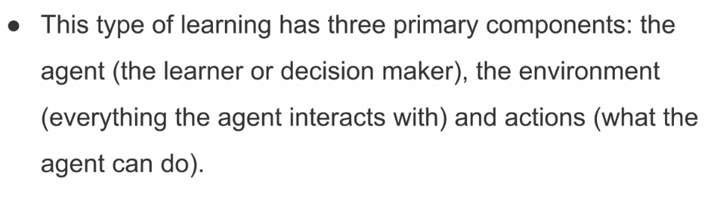

Slide 14
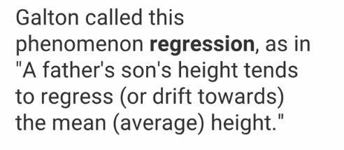

Slide 15
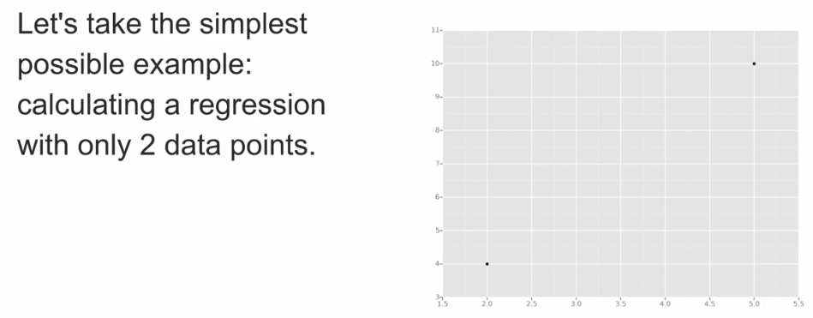
Least squares is a statistical method used to determine a line of best fit by minimizing the sum of squares created by a mathematical function. A "square" is determined by squaring the distance between a data point and the regression line.

Slide 16
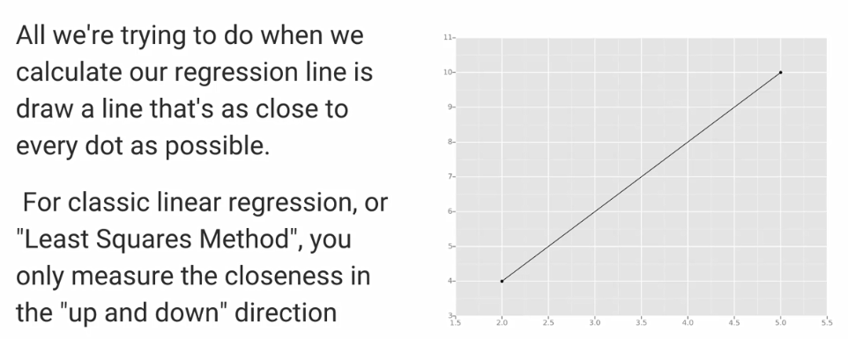

Slide 17
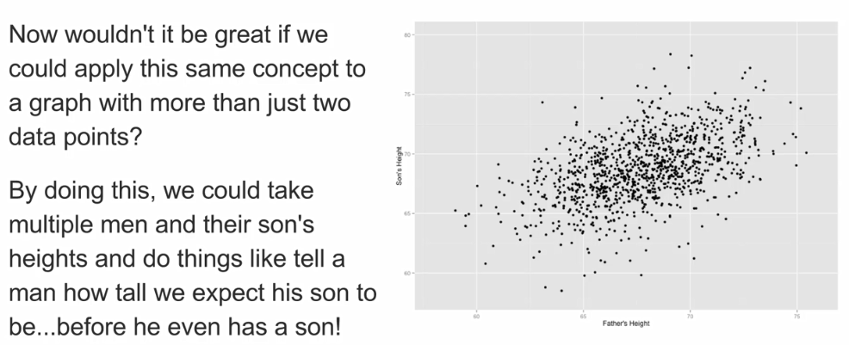

Slide 18
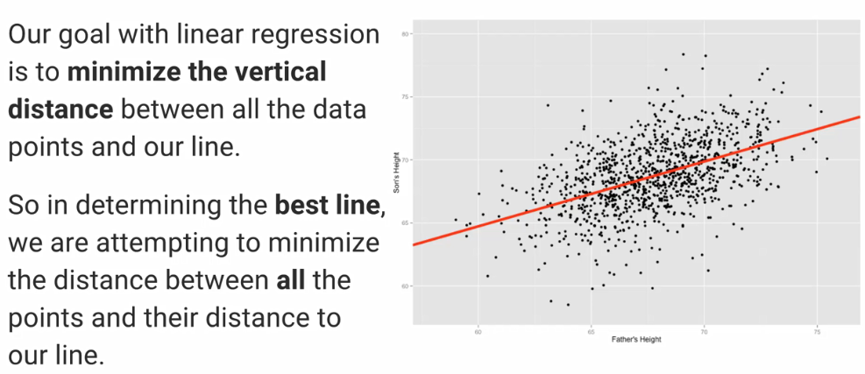

Slide 19
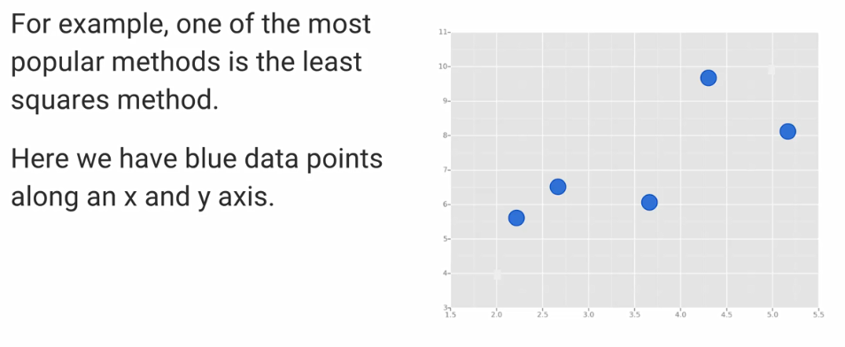

Slide 20
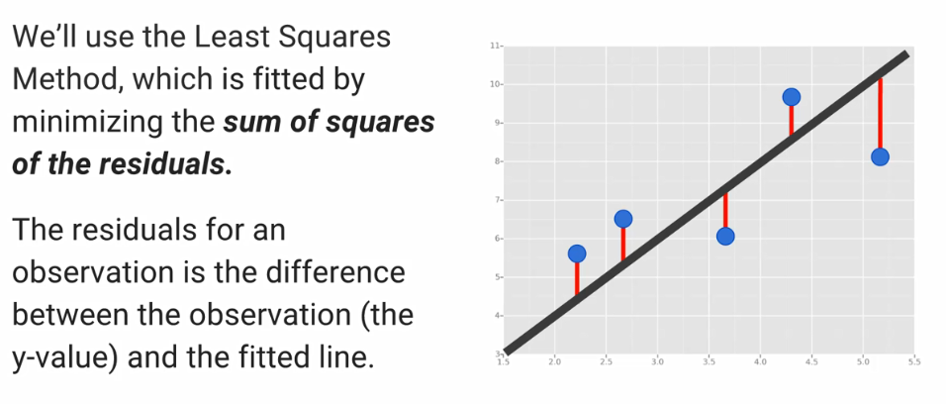

Slide 21
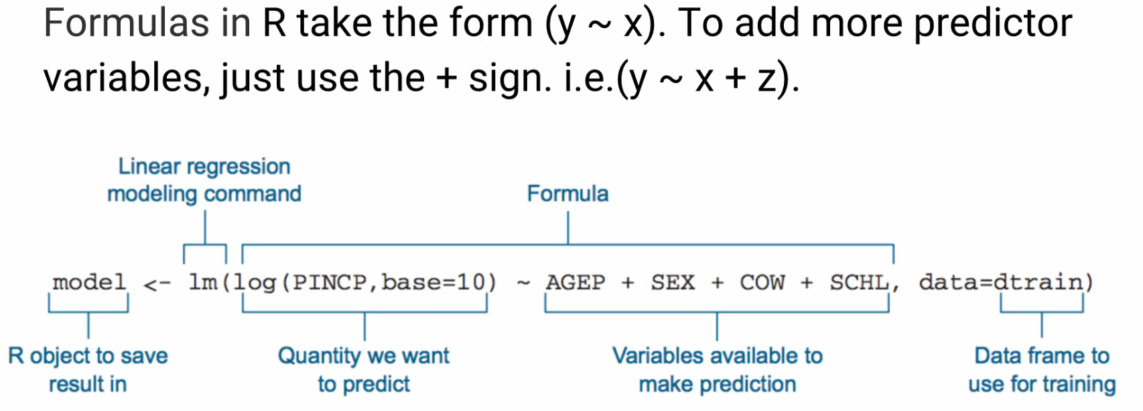

Slide 22
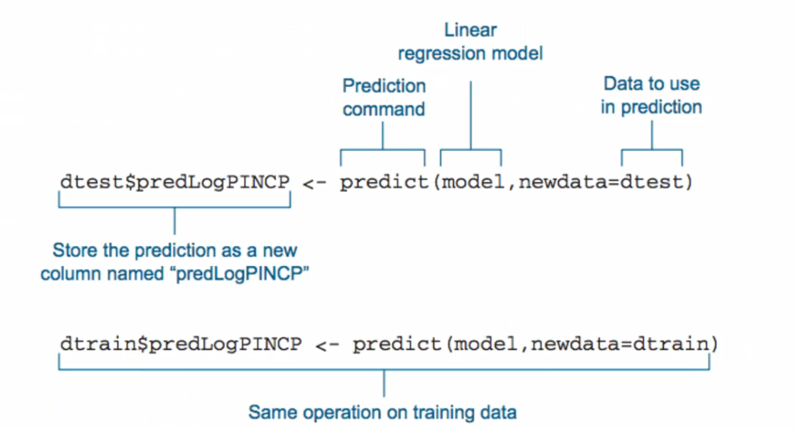

Slide 23
Attributes for both student-mat.csv (Math course) and student-por.csv (Portuguese language course) datasets:
school - student's school (binary: 'GP' - Gabriel Pereira or 'MS' - Mousinho da Silveira)
sex - student's sex (binary: 'F' - female or 'M' - male)
age - student's age (numeric: from 15 to 22)
address - student's home address type (binary: 'U' - urban or 'R' - rural)
famsize - family size (binary: 'LE3' - less or equal to 3 or 'GT3' - greater than 3)
Pstatus - parent's cohabitation status (binary: 'T' - living together or 'A' - apart)
Medu - mother's education (numeric: 0 - none, 1 - primary education (4th grade), 2 â€“ 5th to 9th grade, 3 â€“ secondary education or 4 â€“ higher education)
Fedu - father's education (numeric: 0 - none, 1 - primary education (4th grade), 2 â€“ 5th to 9th grade, 3 â€“ secondary education or 4 â€“ higher education)
Mjob - mother's job (nominal: 'teacher', 'health' care related, civil 'services' (e.g. administrative or police), 'at_home' or 'other')
Fjob - father's job (nominal: 'teacher', 'health' care related, civil 'services' (e.g. administrative or police), 'at_home' or 'other')
reason - reason to choose this school (nominal: close to 'home', school 'reputation', 'course' preference or 'other')
guardian - student's guardian (nominal: 'mother', 'father' or 'other')
traveltime - home to school travel time (numeric: 1 - less than 15 min., 2 - 15 to 30 min., 3 - 30 min. to 1 hour, or 4 - more than 1 hour)
studytime - weekly study time (numeric: 1 - less than 2 hours, 2 - 2 to 5 hours, 3 - 5 to 10 hours, or 4 - more than 10 hours)
failures - number of past class failures (numeric: n if between 1 and 3 , else 4)

Slide 24
Attributes for both student-mat.csv (Math course) and student-por.csv (Portuguese language course) datasets:
schoolsup - extra educational support (binary: yes or no)
famsup - family educational support (binary: yes or no)
paid - extra paid classes within the course subject (Math or Portuguese) (binary: yes or no)
activities - extra-curricular activities (binary: yes or no)
nursery - attended nursery school (binary: yes or no)
higher - wants to take higher education (binary: yes or no)
internet - Internet access at home (binary: yes or no)
romantic - with a romantic relationship (binary: yes or no)
famrel - quality of family relationships (numeric: from 1 - very bad to 5 - excellent)
freetime - free time after school (numeric: from 1 - very low to 5 - very high)
goout - going out with friends (numeric: from 1 - very low to 5 - very high)
Dalc - workday alcohol consumption (numeric: from 1 - very low to 5 - very high)
Walc - weekend alcohol consumption (numeric: from 1 - very low to 5 - very high)
health - current health status (numeric: from 1 - very bad to 5 - very good)
absences - number of school absences (numeric: from 0 to 93)
these grades are related with the course subject, Math or Portuguese:
G1 - first period grade (numeric: from 0 to 20)
G2 - second period grade (numeric: from 0 to 20)
G3 - final grade (numeric: from 0 to 20, output target)

Slide 25
Correlation and CorrPlots
From Wikipedia, correlation is defined as:
In statistics, dependence or association is any statistical relationship, whether causal or not, between two random variables or two sets of data. Correlation is any of a broad class of statistical relationships involving dependence, though in common usage it most often refers to the extent to which two variables have a linear relationship with each other. Familiar examples of dependent phenomena include the correlation between the physical statures of parents and their offspring, and the correlation between the demand for a product and its price.
Correlation plots are a great way of exploring data and seeing if there are any interaction terms. Let's start off by just grabbing the numeric data (we can't see correlation for categorical data):

Slide 26
# The general model of building a linear regression model in R
# looks like this:
# model <- lm(y ~ x1 + x2,data)
# or to use all the features in your data
# model <- lm(y ~. , data) # Uses all features
# Training our model
model <- lm(G3 ~ ., data = train) # or just train
#
# Residuals:
#
# Min 1Q Median 3Q Max
# -7.8110 -0.5178 0.2039 1.0340 3.7861
#

Slide 27
# The residuals are the difference between the actual values of the variable you're predicting
# and predicted values from your regression--y - y.
# For most regressions you want your residuals to look like a normal distribution when plotted.
# If our residuals are normally distributed, this indicates the mean of the difference between our
# predictions and the actual values is close to 0 (good) and that when we miss, we're missing both
# short and long of the actual value, and the likelihood of a miss being far from the actual value
# gets smaller as the distance from the actual value gets larger.
# absences *** - there is a low chance that absences are not significant in calculating G3
# R-squared - goodness of the model; higher is good
# High R-squared indicates good correlation, but Correlation does now always imply causation

Slide 28
Model Interpretation
Understanding requires a general understanding of statistics, check out Wikipedia for overviews on some of these topics, as well as the ISLR book. Here's a quick guide on understanding the model summary:

Slide 29
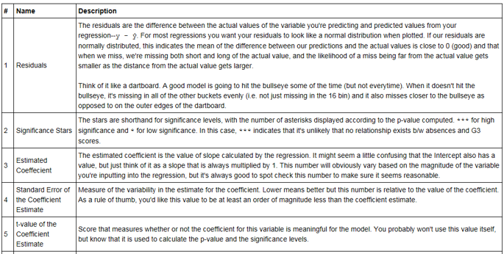

Slide 30
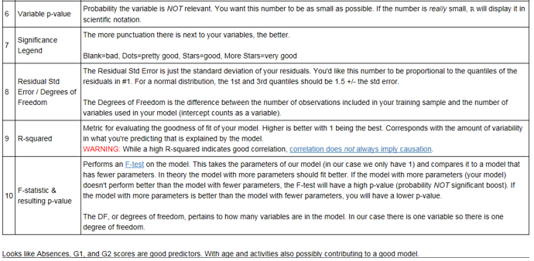

Slide 31
We can determine whether a predictive model is under fitting or overfitting the training data by looking at the prediction error on the training data and the evaluation data.
Your model is under fitting the training data when the model performs poorly on the training data. This is because the model is unable to capture the relationship between the input examples (often called X) and the target values (often called Y).
Your model is overfitting your training data when you see that the model performs well on the training data but does not perform well on the evaluation data. This is because the model is memorizing the data it has seen and is unable to generalize to unseen examples.
Ref: Amazon Machine Learning

Slide 32
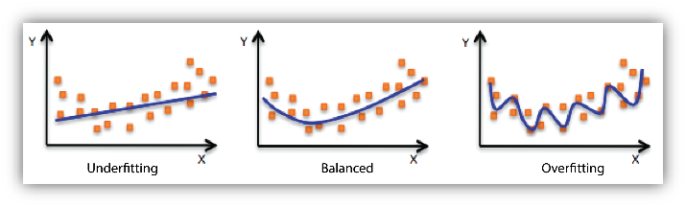
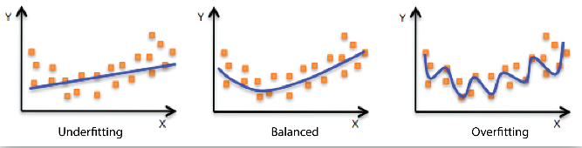
Ref: Amazon Machine Learning

Slide 33
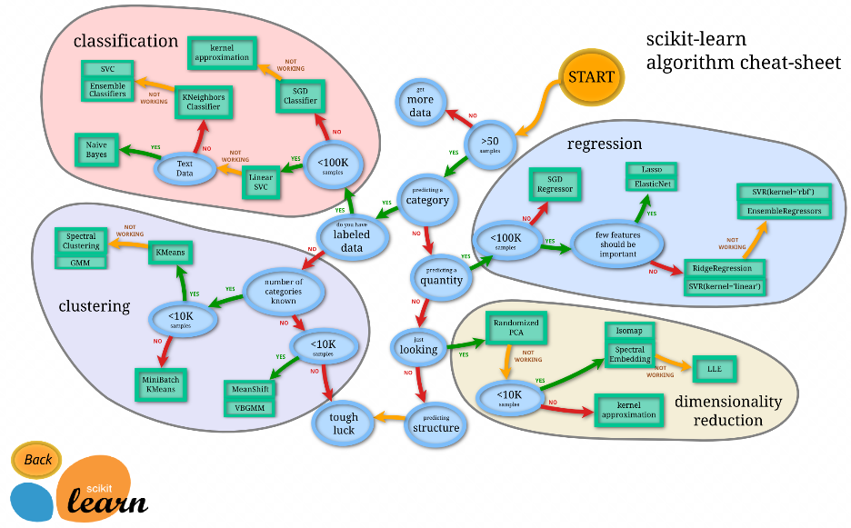

Slide 34
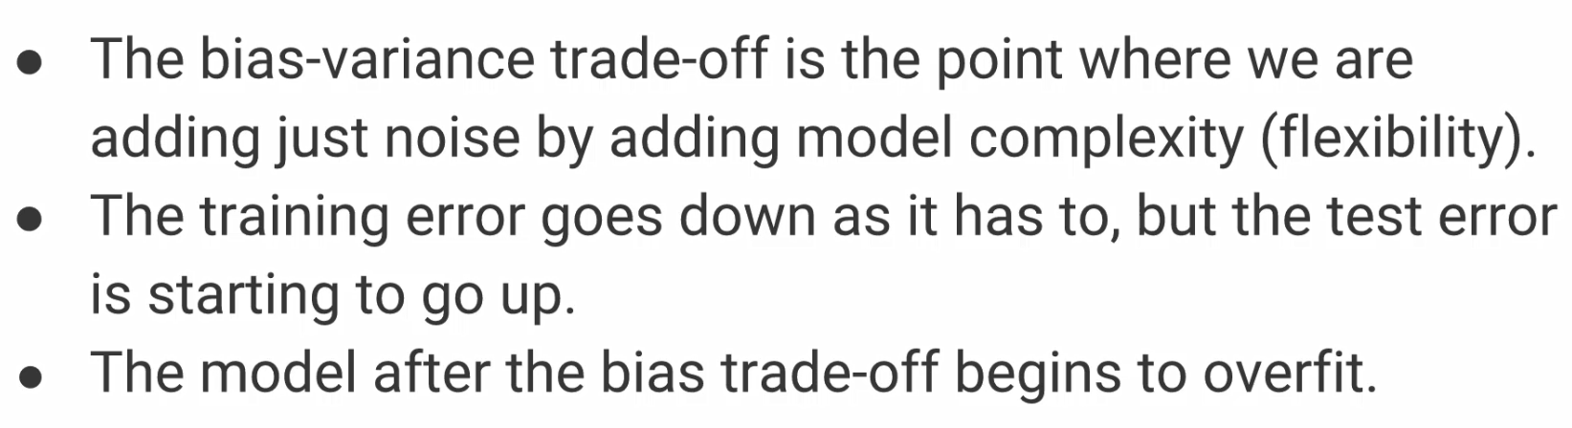

Slide 35
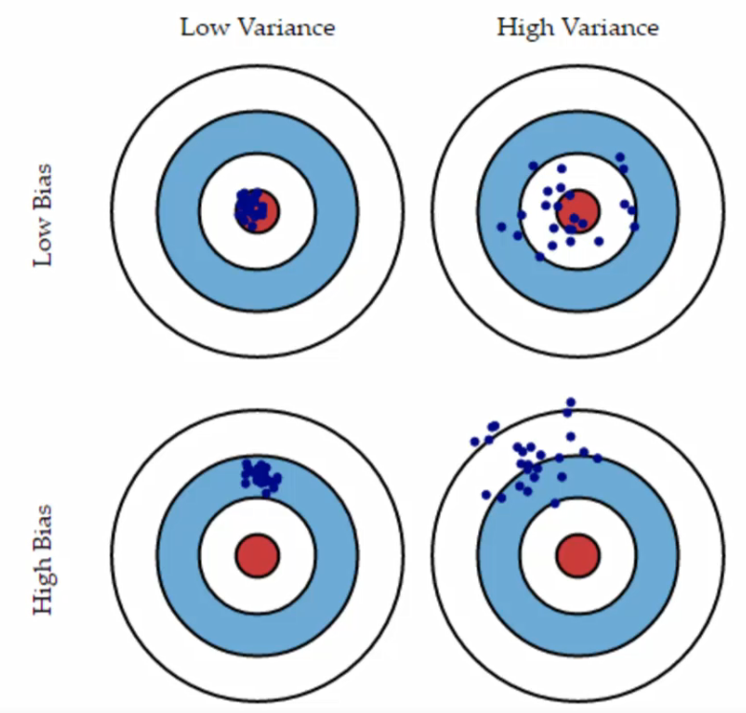

Slide 36
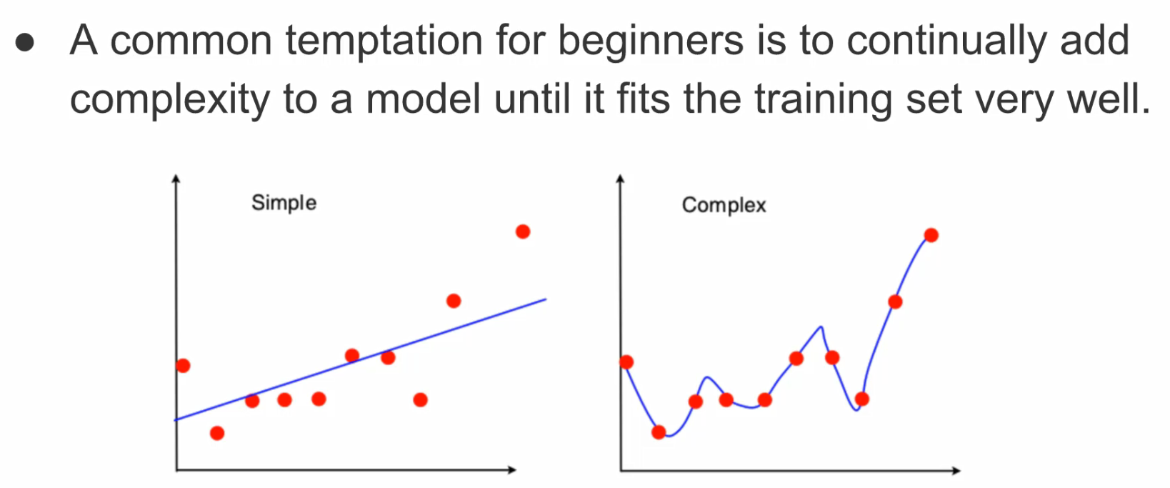

Slide 37
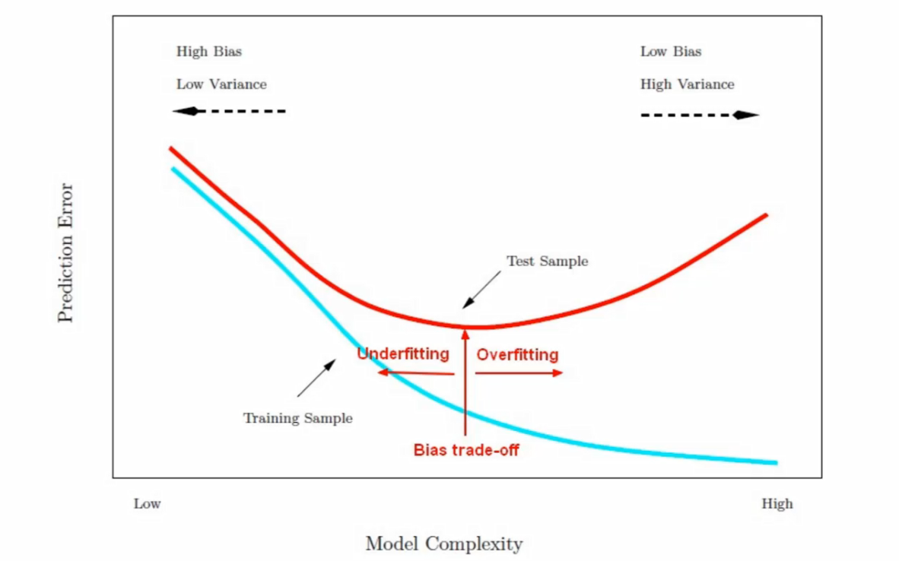

Slide 38
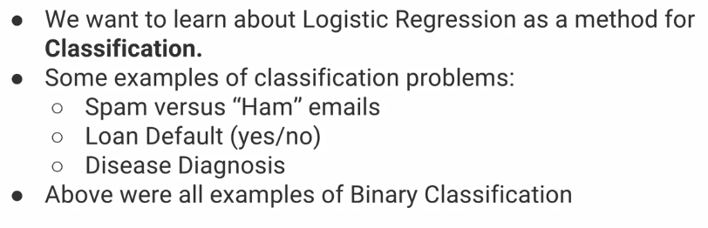

Slide 39
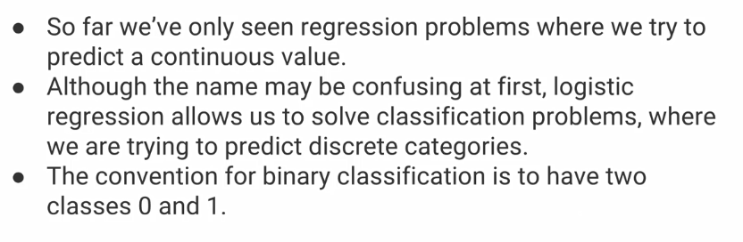

Slide 40
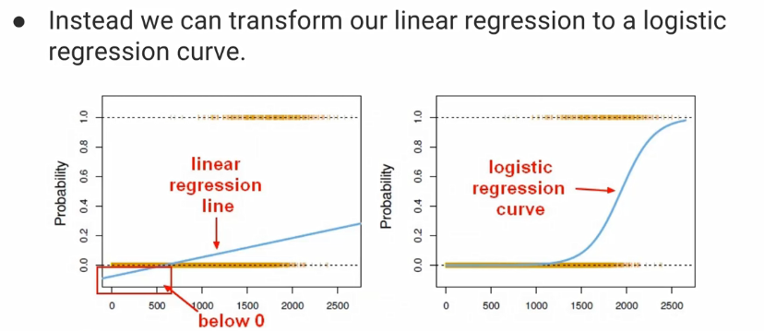

Slide 41
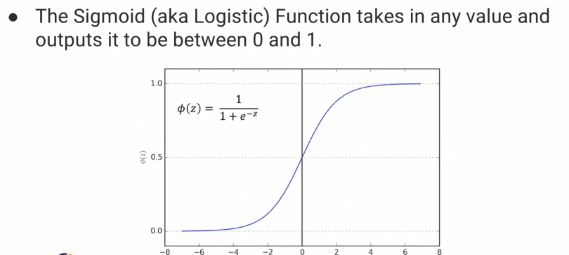

Slide 42
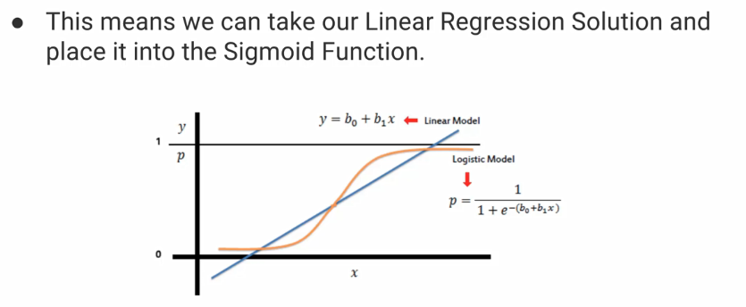

Slide 43
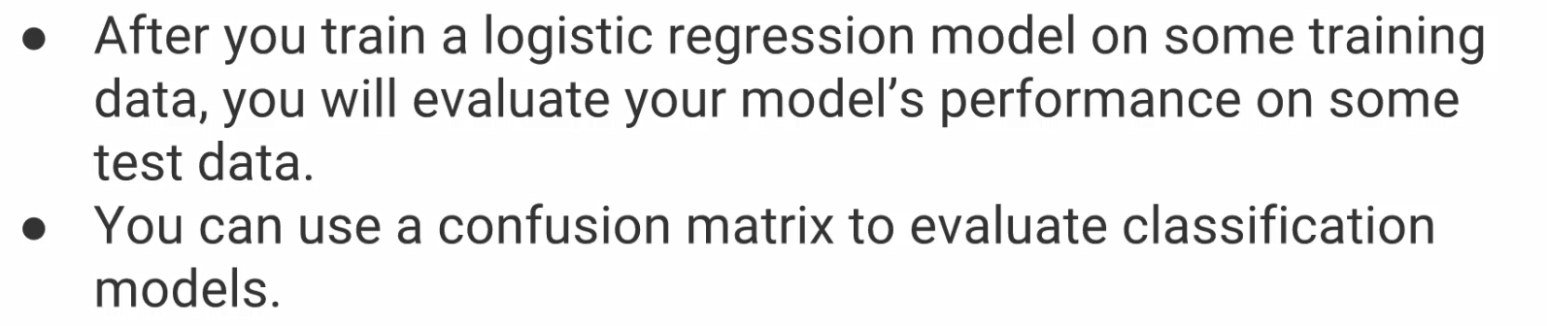

Slide 44
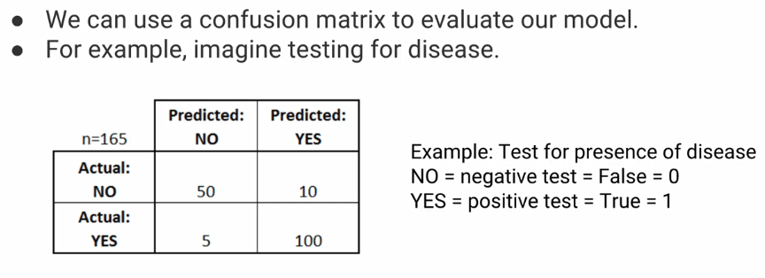

Slide 45
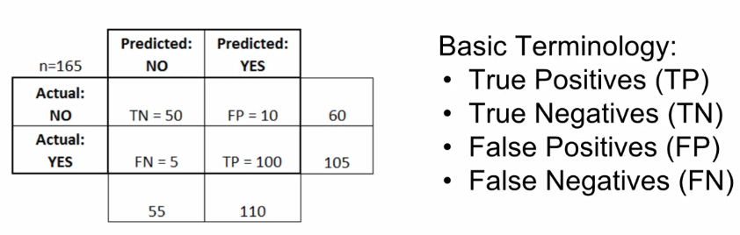

Slide 46
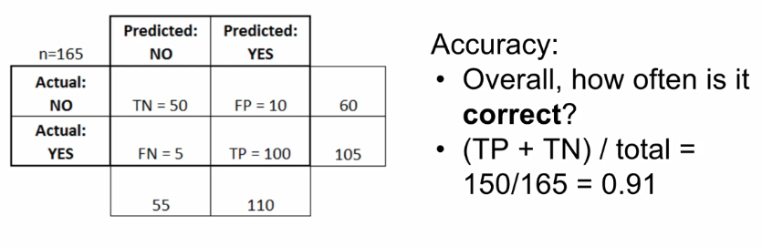
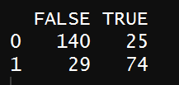
TP + TN = 74 + 140 = 214
Total = 169 + 99 = 268
Correctness: 214/268 = 0.79

Slide 47
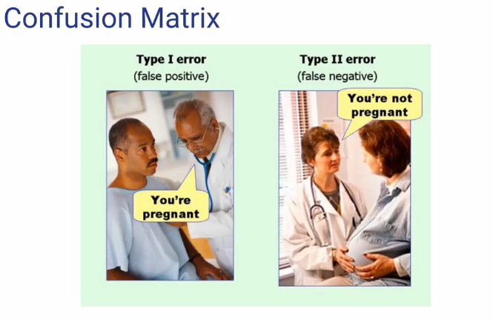

Slide 48
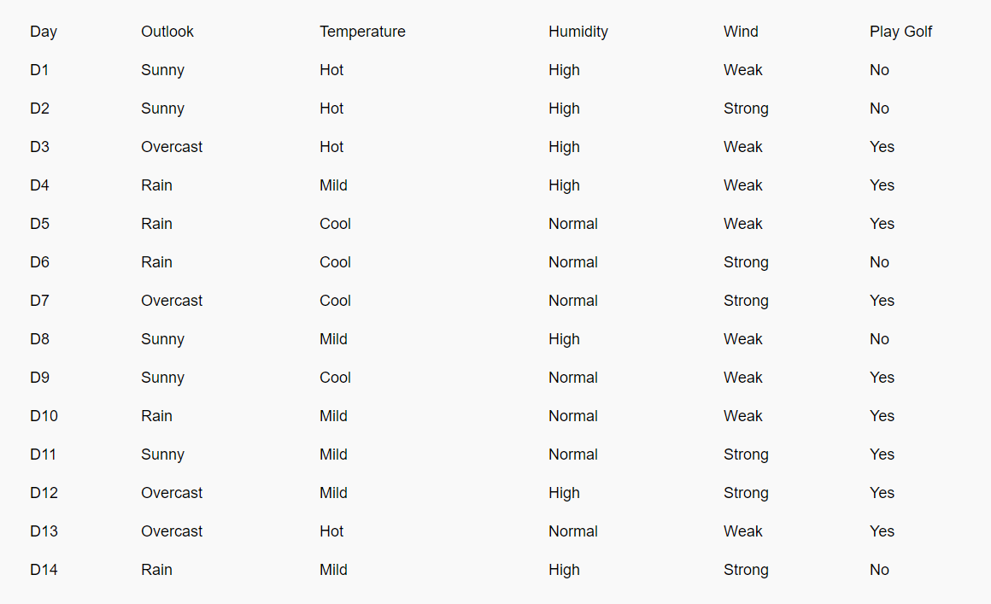

Slide 49
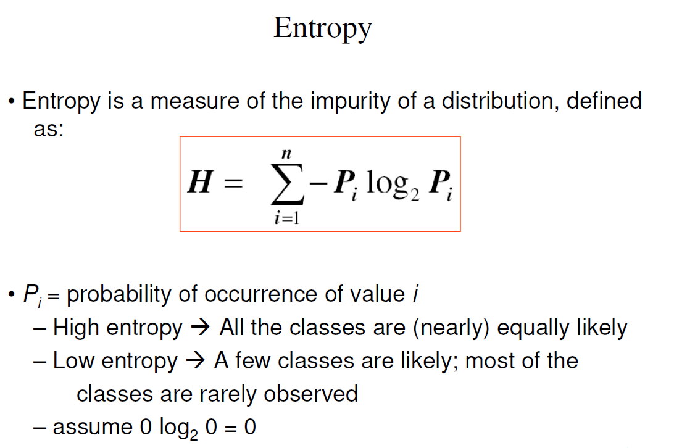

Slide 50
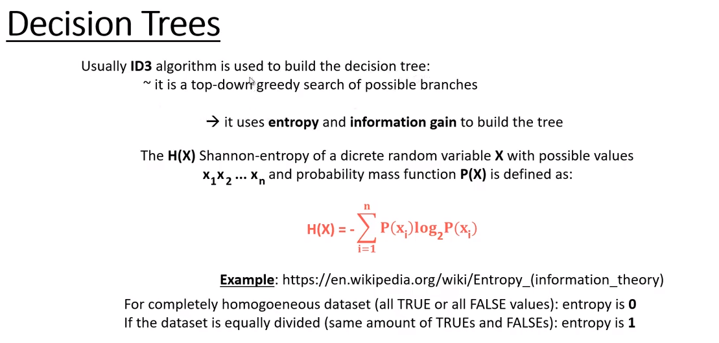

Slide 51
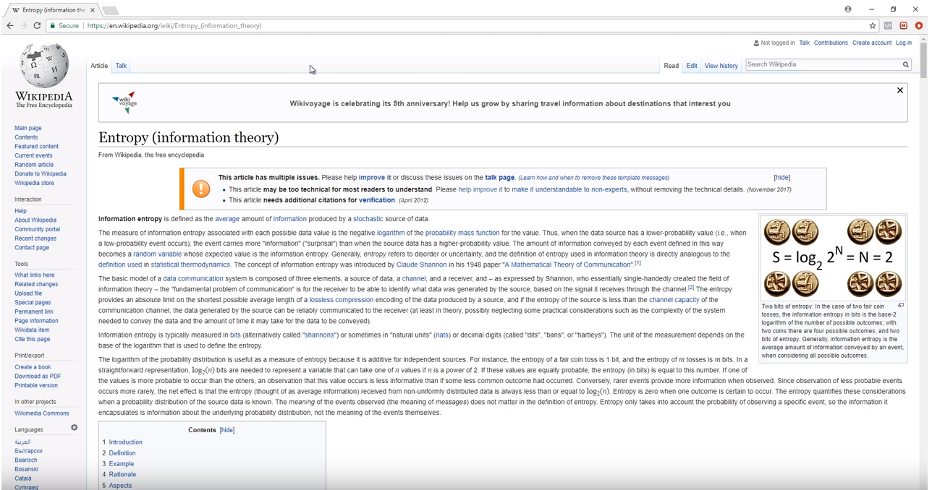

Slide 52
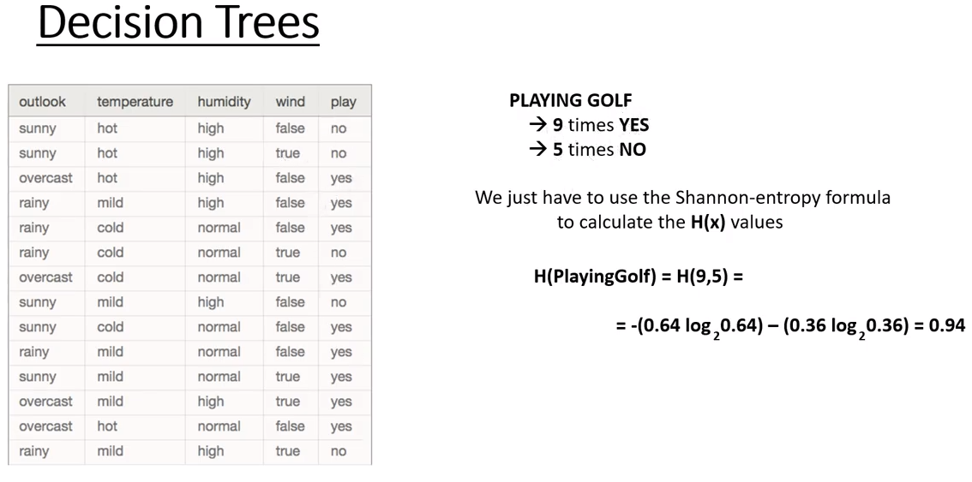

Slide 53
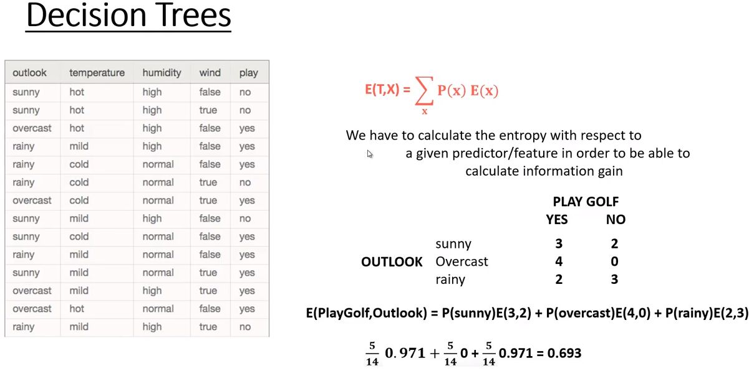

Slide 54
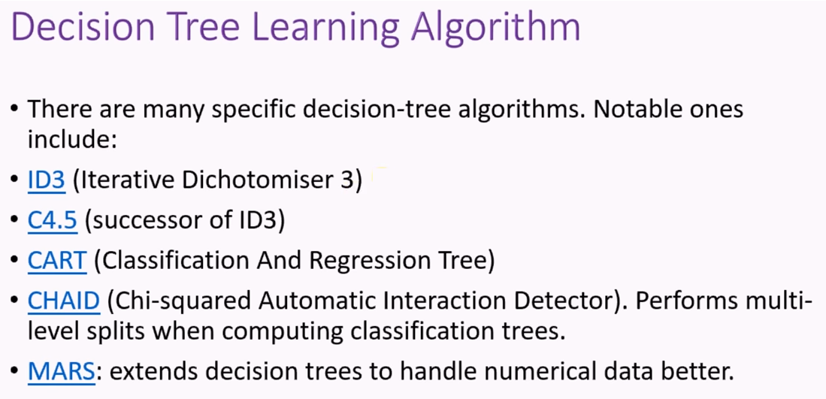

Slide 55


Slide 56


Slide 57


Slide 58


Slide 59


Slide 60


Slide 61


Slide 62


Slide 63


Slide 64


Slide 65


Slide 66


Slide 67


Slide 68


Slide 69


Slide 70


Slide 71


Slide 72


Slide 73


Slide 74


Slide 75


Slide 76


Slide 77


Slide 78


Slide 79


Slide 80


Slide 81


Slide 82


Slide 83


Slide 84


Slide 85


Slide 86


Slide 87


Slide 88


Slide 89


Slide 91


Slide 92


Slide 93


Slide 94


Slide 95


